Slide 1



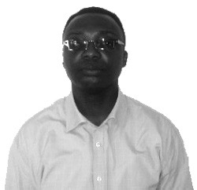
Charles Tortoe (Dr.) – Analyst
Professional experience
Education and skills
Council for Scientific and Industrial Research-Food Research Institute (CSIR-Food Research Institute) – Accra, Ghana. Occupied various positions over a 21 year period, serving as
Acting Director
Deputy Director
Head of Division of Food Technology Research Division
Principal Research Scientist
Head of Division of Food Processing and Engineering Division
Senior Research Scientist
Research Scientist
Dr. Tortoe has a PHD from the University of Greenwich (United Kingdom)
He also holds an MPhil in Botany (Microbiology) and a BSc. degree in Botany, both from the University of Ghana, Legon (Ghana)
Introduction
Dr. Tortoe specializes in food processing and preservation of root and tuber crops, fruits and vegetables and cereals and legumes. He is also experienced in
product development, food safety and quality control, HACCP, training, development and promoting farmers, processors, Micro-Small-Medium Scale Enterprises in Ghana.

